Slide 1
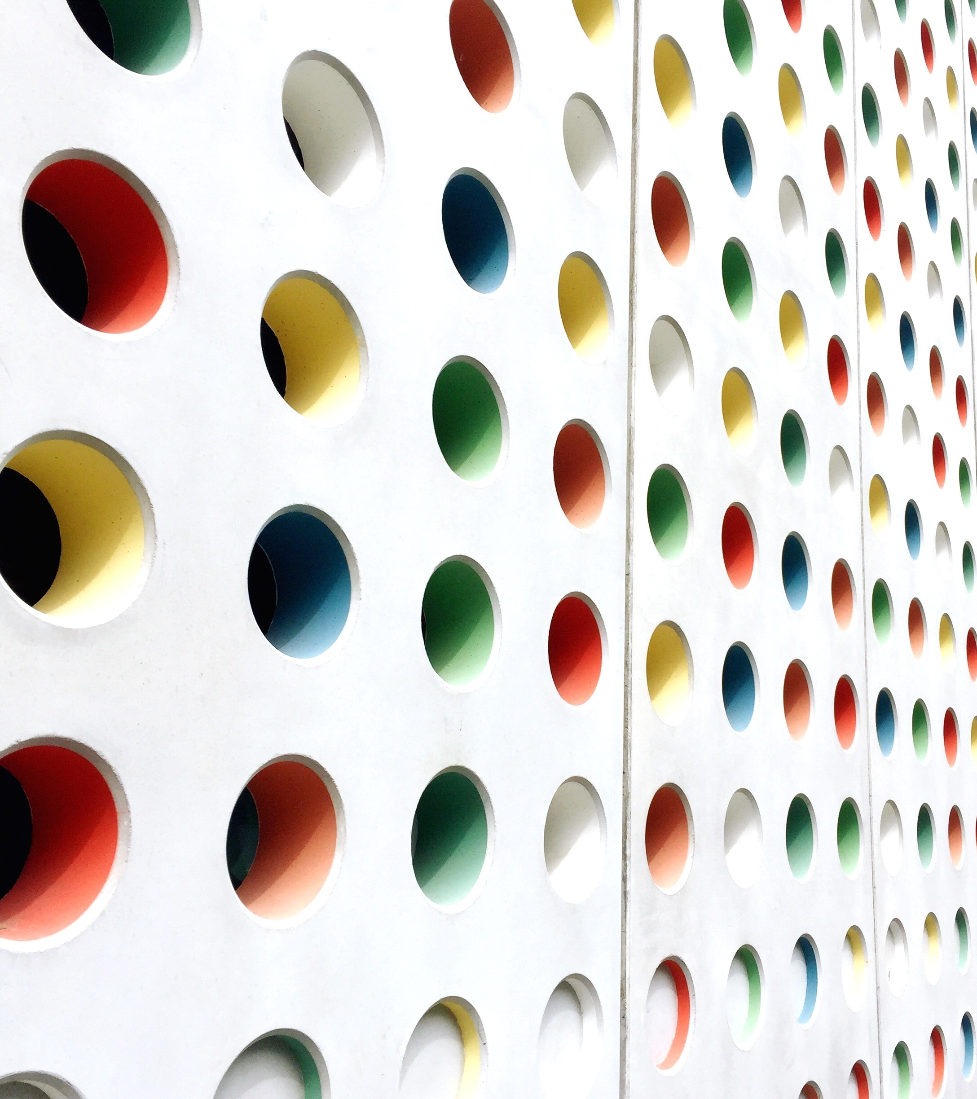
Detect human emotion through the images
Team 8:
Adelene Ng
Wong Cheng Kwan
Perumal Srinivas

Slide 2
Objective
The objective of this project is to develop a deep learning model to detect the human facial emotion through images
Given an image or video footage of people, it is able to predict the 7 different facial emotion expressions: angry, disgust, fear, happy, neutral, sad and surprise.

Slide 3
Task Allocation
No | Tasks | Team Members
1 | Understanding of Business Case | All
2 | Data Understanding | All
3 | Data Preparation | All
4 | VGGNet16 (Wong Cheng Kwan) MobileNetV1 (Perumal Srinivas) DenseNet121 (Adelene Ng) | Individual
5 | Evaluation | Individual
6 | Project Presentation | All

Slide 4
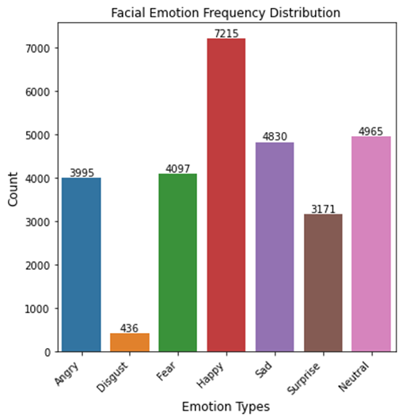
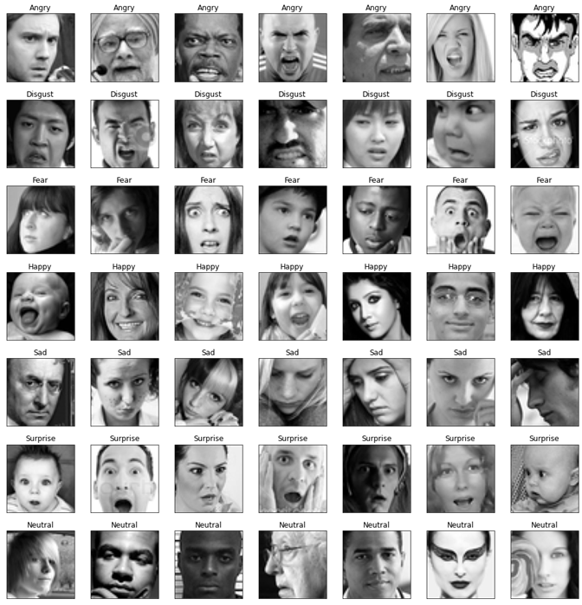
Dataset Used
Facial Expression Recognition - 2013 from Kaggle
48 x 48 x 1 (gray scale)
stored in csv
The training set consists of 28,709 labelled images, and 7178 images in the test set

Slide 5
Deep Learning Models
VGGNet16 (Wong Cheng Kwan)
MobileNetV1 (Perumal Srinivas)
DenseNet121 (Adelene Ng)

Slide 6
DenseNet121

Slide 7
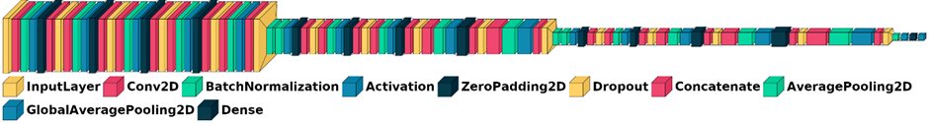
DenseNet121
Advantages
reduces the vanishing-gradient problem
strengthens feature propagation
encourages feature reuse
substantially reduces the number of parameters
92 layers with a total of 2,377,958 parameters

Slide 8
Experiments Conducted for DenseNet121
Run | Description | Batch size | # Epochs | Learning rate | Optimizer | Dropout | ES – Patience | Loss | Best Parameter | Accuracy
1 | Baseline | 128 | 108/200 | 0.0001 | Adam | 0.4 | 20 | 1.5 |  | 59.1%
2 | ReduceLROnPlateau | 128 | 91/200 | 0.0001 | Adam | 0.4 | 20 | 1.5 |  | 57.4%
3 | Vary Dropout Rates | 128 | 59/200 | 0.0001 | Adam | 0.8 | 20 | 2.3 |  | 25.5%
4 | Vary Dropout Rates | 128 | 42/200 | 0.0001 | Adam | 0.2 | 20 | 1.2 |  | 61.6%
5 | Vary Dropout Rates | 128 | 40/200 | 0.0001 | Adam | 0.1 | 20 | 1.3 |  | 60.1%
6 | Vary Optimizers | 128 |  | 0.0001 | SGD, Adam | 0.4 | 20 |  | Adam | 58.5%
7 | Vary Learning Rates | 128 |  | 0.001, 0.0001, 0.00001 | Adam | 0.4 | 20 |  | 0.001 | 60.0%
8 | Vary Batch Sizes | 32, 64, 128 |  | 0.0001 | Adam | 0.4 | 20 |  | 64 | 56.5%

Slide 9
Concluding Experiments
Using the best parameters from the previous runs,
Batch size | # Epochs | Learning rate | Optimizer | Dropout | ES - Patience | Loss | Accuracy
64 | 43/200 | 0.001 | Adam | 0.2 | 20 | 1.5301 | 60.8%
64 | 81/200 | 0.001 | Adam | 0.2 | 20 | 1.0264 | 67.2%
Parameter | Description | Value
rescale | Rescales the pixel values of the image to be between [0, 1] | 1./255
rotation_range | Randomly rotates the image clockwise by 15⁰ | 15
width_shift_range | Horizontal shift of the image. Shift image width by 15% | 0.15
height_shift_range | Vertical shift of the image. Shift image height by 15% | 0.15
shear_range | Shear the image by 15% | 0.15
zoom_range | Randomly zooms in or out of the image in the range of [1 - 0.15, 1 + 0.15] | 0.15
horizontal_flip | Flips along the horizontal axis. | True
fill_mode | Points outside the boundaries of the input are filled according to the given mode, in this case it will fill the area with the nearest pixel. | 'nearest'
Data Augmentation Parameters

Slide 10
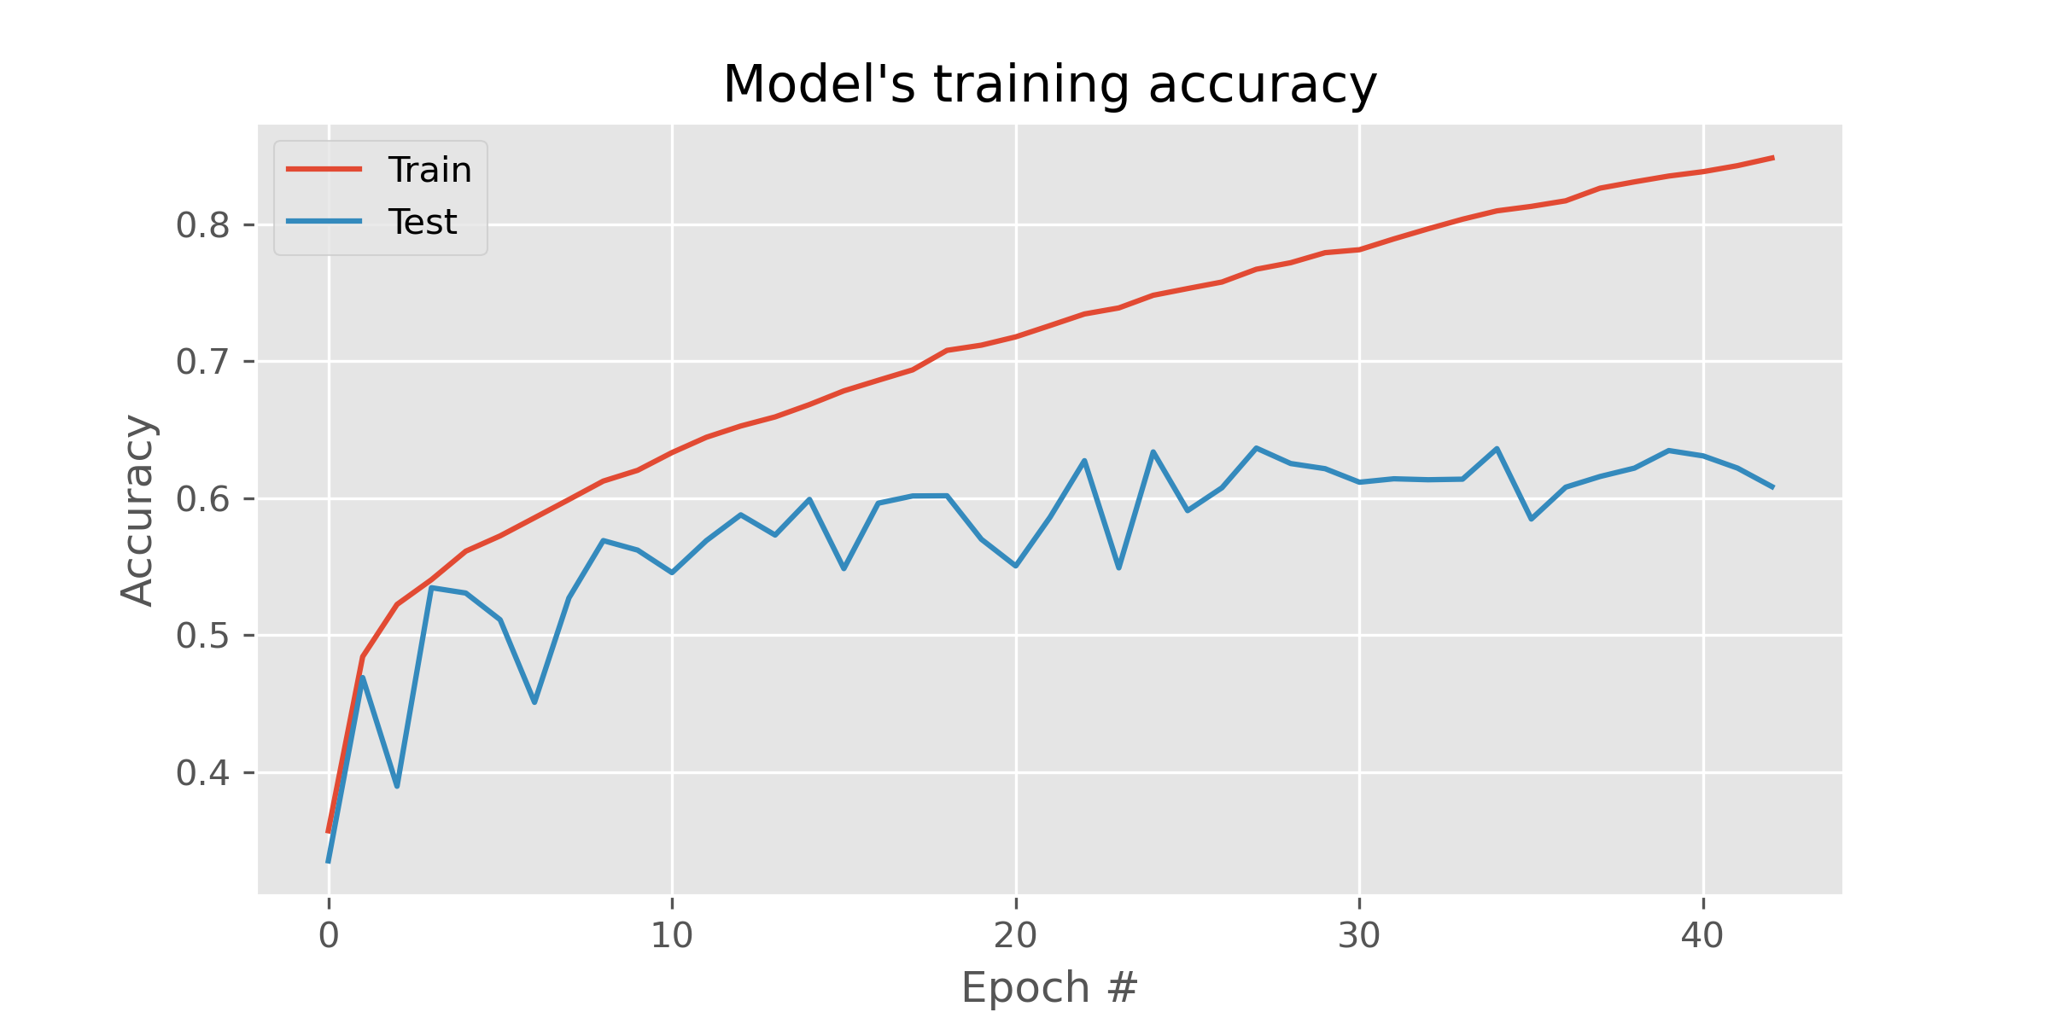
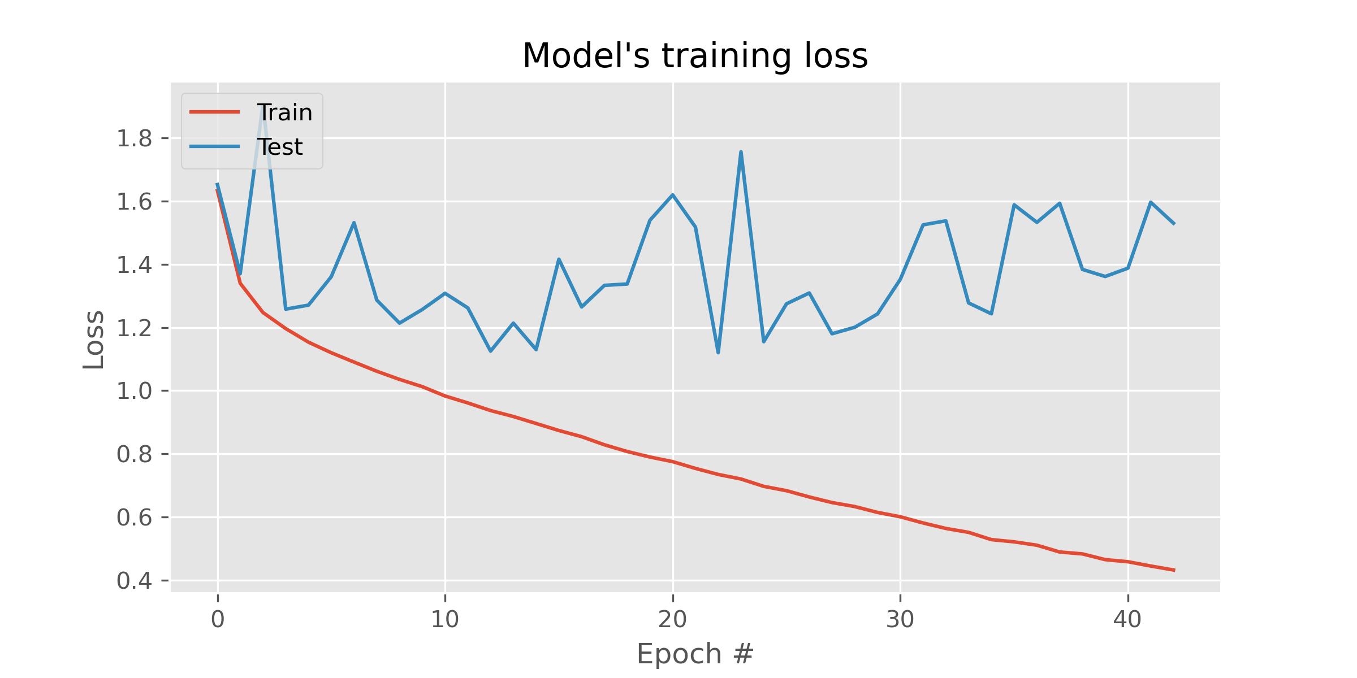
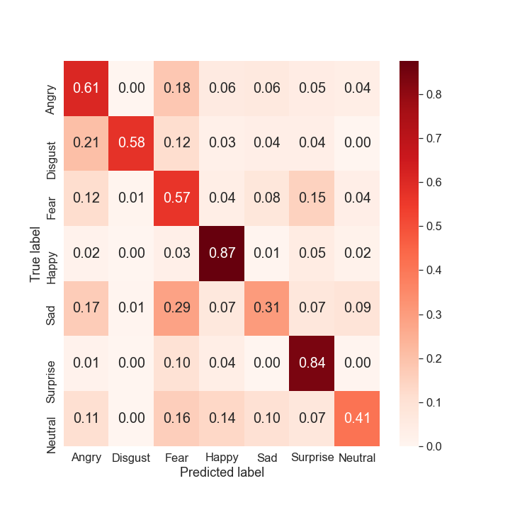
Using best parameters from previous runs
Notes:
Our model is very good at detecting smiles and surprised expressions, but is unable to pick up on more varied emotions such as sadness or neutrality, which can look different on different people. When run against the test images, the model was unable to predict fear, neutral and sadness correctly

Slide 11
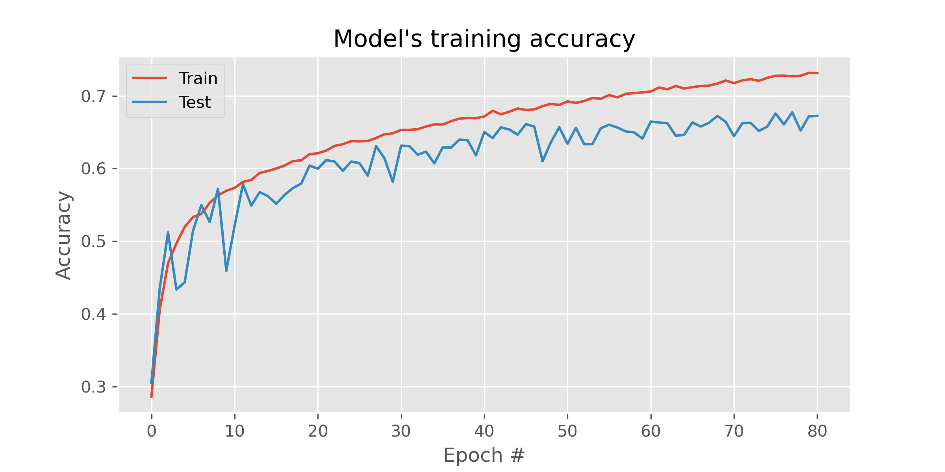
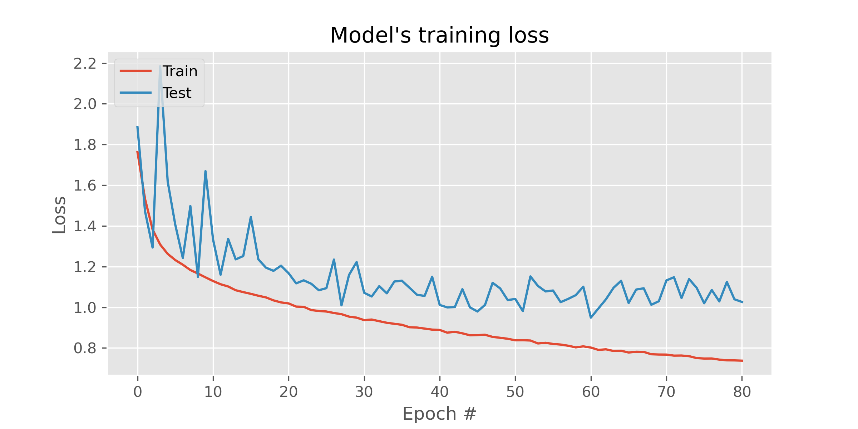
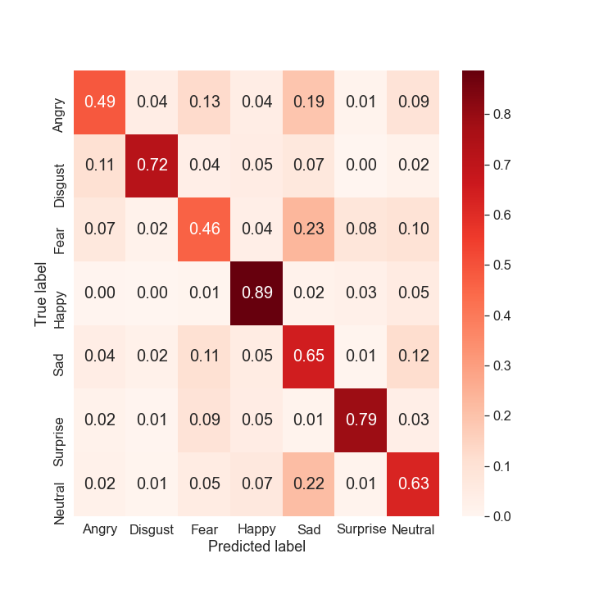
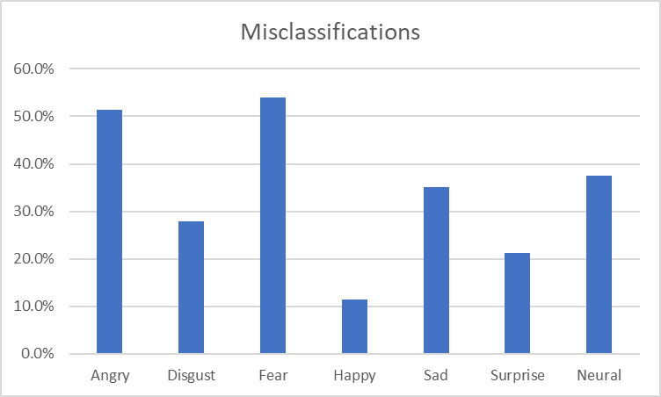
Final results with Data Augmentation
Notes:
After applying data augmentation, we see that happiness, disgust and surprise have many correct classifications, sadness, and neutrality have some correct classifications, and anger and fear have few correct classifications. These results imply that our model is very good at detecting smiles, disgust and surprise, but is unable to pick up on more varied emotions such as anger or fear, which can look different on different people. In the dataset, we observe there were very few disgust images. This explains the poor performance before augmentation. Data augmentation seems to have produced a more ‘even’ spread of the different classifications unlike in previous runs.
Happy and Surprise show the least misclassifications, the former emotion most likely due to having the highest number of training samples in the dataset. Sadness and Neutral emotions have similar number of misclassifications and their distribution is comparable. These emotions can look different on different persons and are subjective. Anger and fear show similar misclassifications too and they have similar distributions too. Disgust surprisingly showed quite a low number of misclassifications, in spite having the fewest number of training images

Slide 12
Future Improvements
Applying model averaging ensemble techniques for facial emotion classification
Use a pre-trained model as a feature extractor (transfer learning)
Over and under-sampling techniques to handle class imbalance in the dataset
Notes:
Ref: https://towardsdatascience.com/handling-imbalanced-datasets-in-deep-learning-f48407a0e758

Slide 13
VGG16Net

Slide 14
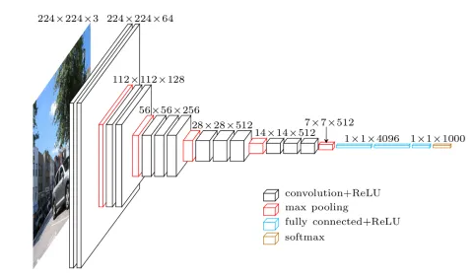
VGG16net
Advantages
Grouping multiple convolution layers with smaller kernel sizes instead of one Conv layer with large kernel size.
Reduce number of features at the output
Include multiple RELU layers instead of one
Increase learning instances

Slide 15
Why VGG16, and not VGG19
VGG 19 have extra three convolution layers with learnable weights over VGG16.
VGG19 is having 15.8% more learnable weights for computations.
VGG19 yield less than 1% of accuracy improvement over VGG16.
 | Model | Batch Size | Dropout | Epochs with Early Stopping | Learning Rate | Optimizers | Validation accuracy
1 | VGG16(base) | 64 | - | 25 / 200 | 1e-4 | Adam | 58.65%
2 | VGG19 | 64 | - | 26 / 200 | 1e-4 | Adam | 59.07%

Slide 16
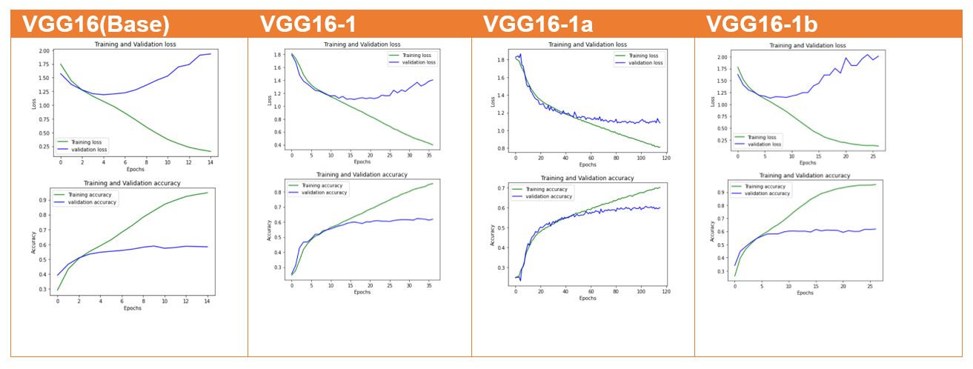
Baseline – with different dropout rate
Although VGG16-1 is having the highest accuracy, VGG16-1a is a better fit, as decreases to a point of stability with a minimal gap between the two final loss values.
We used VGG16-1a as our baseline for VGG16 model.
Model | Dropout
VGG16-1 | 0.5
VGG16-1a | 0.8
VGG16-1b | 0.2

Slide 17
Experiments Conducted for VGG16
Run | Model | Batch Size | Epochs with Early Stopping | Patience by ‘val_loss’ | Learning Rate | Optimizers | Val_accuracy
1 | VGG16(base) | 64 | 25 / 200 | 10 | 1e-4 | Adam | 58.65%
2 | VGG16-1 (dropout = 0.5) | 64 | 37 / 200 | 10 | 1e-4 | Adam | 62.11%
3 | VGG16-1a (dropout = 0.8) | 64 | 116 / 200 | 10 | 1e-4 | Adam | 60.69%
4 | VGG16-1b (dropout = 0.2) | 64 | 27 / 200 | 10 | 1e-4 | Adam | 61.00%
5 | VGG19 | 64 | 26 / 200 | 10 | 1e-4 | Adam | 59.07%
6 | VGG16-2 | 128 | 86/200 | 10 | 1e-4 | Adam | 58.00%
7 | VGG16-3 | 128 | 14 / 200 | 10 | 1e-3 | Adam | 24.94%
8 | VGG16-4 | 128 | 45 / 200 | 10 | 1e-5 | Adam | 25.00%
10 | VGG16-6 | 128 | 200 / 200 | 10 | 1e-4 | SGD | 24.94%
11 | VGG16-1C | 128 | 115/200 | 20 | 1e-4 | Adam | 57.54%
12 | VGG16-2a (augmentation) | 128 | 133 / 200 | 10 | 1e-4 | Adam | 25%

Slide 18
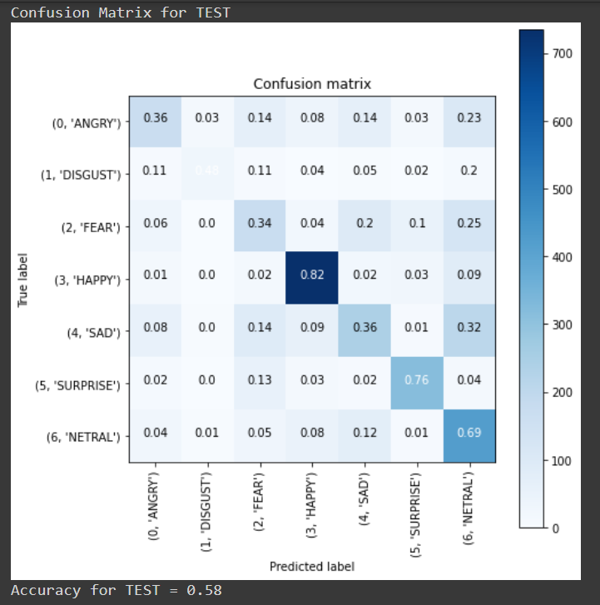
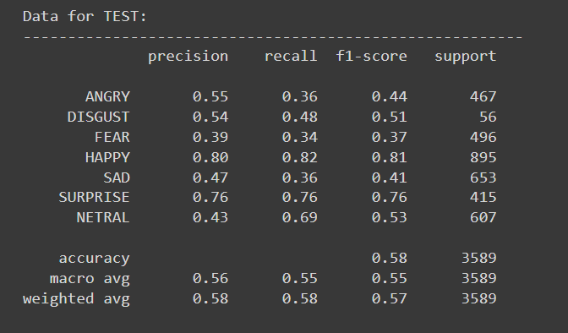
Observation with confusion matrix – VGG16-02
HAPPY is getting the highest prediction accuracy, while FEAR is having the lowest.
The model is not able to predict NEUTRAL well and mistaken it for SAD, FEAR or ANGRY.

Slide 19
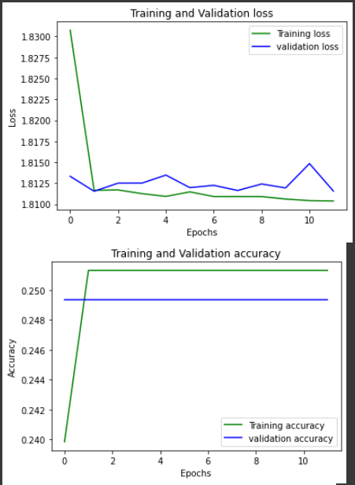
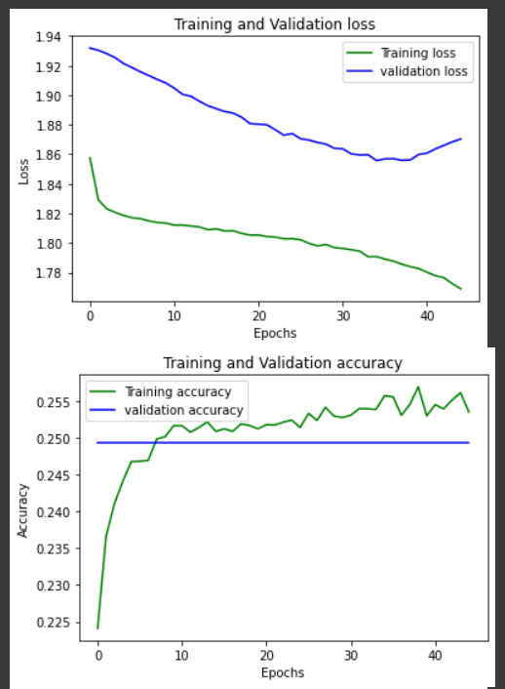
Learning Rate – VGG16-2, VGG16-3, VGG16-4
VGG16-3
VGG16-4
VGG16-3, where learning is large, caused the model to converge too quickly to a suboptimal solution.
VGG16-4, where learning rate is too small, is showing traits of diverging.
Model | Learning Rate
VGG16-2 | 1e-4
VGG16-3 | 1e-3
VGG16-4 | 1e-5

Slide 20
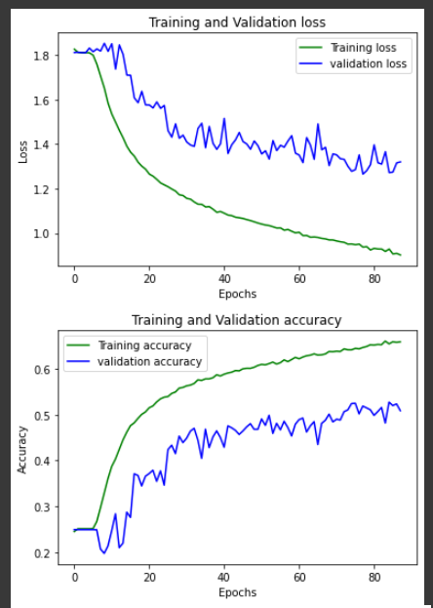
Data Augmentation - VGG16-2a
Augmentation Parameters:
rotation_range=20,
width_shift_range=0.2,
height_shift_range=0.2,
horizontal_flip=True,
brightness_range=[0.2,1.0],
zoom_range=[0.5,1.0]
The result is not as good. The horizontal flips is not a valid image in our domain and may caused the model to memorized these augmented images during training.

Slide 21
More Improvements, if more time and resources allow.
More tuning can be made in Data Augmentation to have more realistic images for that domain.
VGGNet, MobileNet and DenseNet can be strategically combined into another predictive model thru Ensemble Method.

Slide 22
MobileNetV1

Slide 23
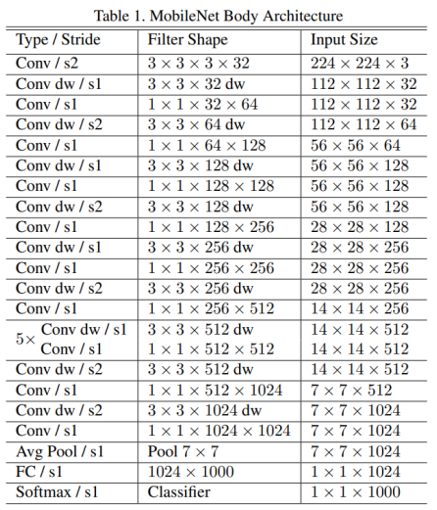
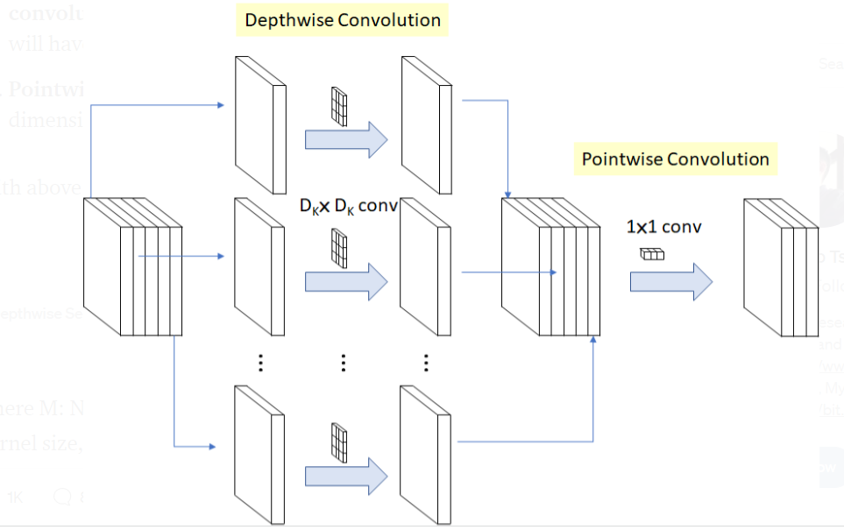
MobileNetV1
Advantages
Sufficiently high accuracy
Low computational complexity
Low energy usage
Small model size

Slide 24
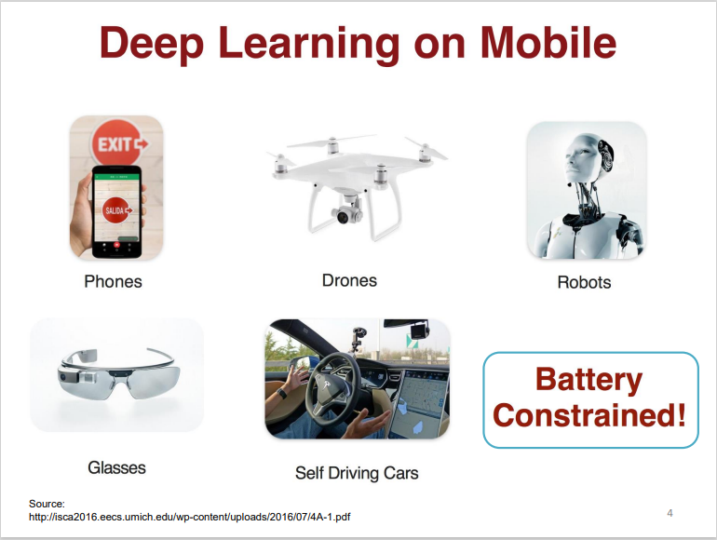
Why MobileNet

Slide 25
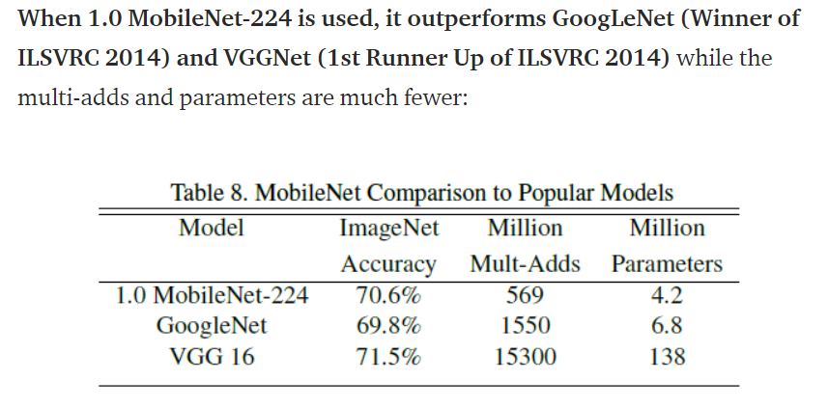
Why MobileNet Comparision

Slide 26
Experiments Conducted for MobileNetv1
Run | Batch size | # Epochs | Learning rate | Parameteters | Optimizer | ES – Patience | Loss | Accuracy
1 | 32 | 83/200 | 0.001 | 44,263 | NAdam | 20 | 1.68 | 50.10%
2 | 128 | 194/200 | 0.001 | 76,327 | NAdam | 20 | 1.41 | 46.92%
3 | 64 | 197/200 | 0.0001 | 76,327 | Adam | 20 | 1.66 | 34.02%
4 | 128 | 105/200 | 0.007 | 44,263 | NAdam | 20 | 1.24 | 53.39%
5 | 128 | 195/200 | 0.001 | 205063 | NAdam | 20 | 1.57 | 38.95%

Slide 27
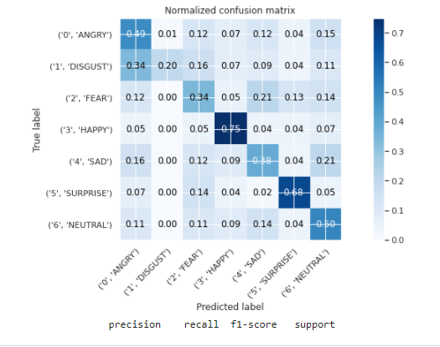
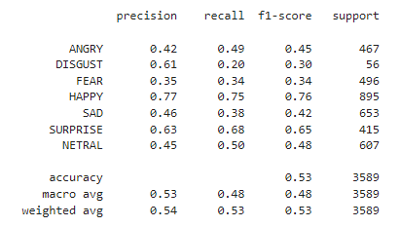
Observation with confusion matrix – MobileNetV1
HAPPY is getting the highest prediction accuracy, while disgust is having the lowest.

Slide 28
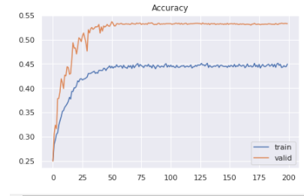
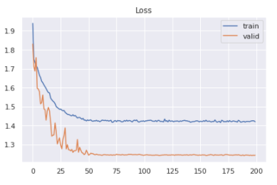
Validation Accuracy and Loss from the best model

Slide 29
Improvements - MobileNetV1
USED
ReduceLROnPlateau was used to reduce the learning rate when a metric has stopped improving.
Data Augmentation Parameters Used
rotation_range=15, Random Rotation
width_shift_range=0.2, Random Width Shift
height_shift_range=0.2,Random Height Shift
Shear_range = 0.14, Sheer Range
Zoom_Range=1.0, Zoom in On Range
.

Slide 30
Improvements to try.
Image Sharpening PIL(Pythom Imaging Library) package using the “Unsharp Mask” filter as FER-2013 has images slightly blurry.
Histogram Equalization SKImage Package particular for applications which require pixel level details.
The Changes in the positions of the fiducial points and the intensities capture the crucial information regarding the emotion of a face. Usage of gradiant and the Laplacian of the input image together with the orginal input into a CNN.

Slide 31
Conclusions & Deployment
Model | Accuracy
VGGNet16 | 58%
MobileNetV1 | 53%
DenseNet121 | 67.2%
Still images
Pass the image to the emotion prediction model
Real time face emotion detection via video camera

